Slide 1
Cloudware Explained

Slide 2
What is Cloudware?
Cloud is used as a collective term for internet delivered IT and communication services. This means that a ‘user’ of these services doesn’t have to own and operate any supporting hardware, software or worry about maintenance. It’s all provided as-a-service and on-demand to any internet enabled device.
Cloudware means all IT and Communication services that are available on-demand through the internet. Think of it as internet generation software and services without the supporting cast of bulky hardware, lengthy installations, annoying updates and expensive maintenance agreements.

Slide 3
What is Compare Cloudware?
Compare Cloudware simplifies the selection and purchase of Information Technology and Communication applications and services available in the Cloud.
Without the need for endless search, time consuming assessment and awkward evaluation, Compare Cloudware offers knowledgable search, intuitive comparison, relevant product reviews and independent user reviews which enable you to choose the right Cloudware for your needs.
The result? Compare Cloudware makes IT and Communications applications and services comparable and accessible with the click of a button.

Slide 4
Why should I use Cloudware?
1. Reduced Risk
It’s distressing enough that personal data loss can mean a lifetime of memories gone forever but for a business it can be fatal. Simply put, data loss kills businesses. According to the UK’s Department of Trade & Industry, over 70% of businesses that suffer data loss close within 18 months.
All Cloudware providers have comprehensive back-up processes and procedures which ensure your data is fully protected around-the-clock in leading edge facilities using the latest infrastructure. Commonly, data is stored in multiple locations to ensure that any single point of potential failure or attack is fully mitigated.

Slide 5
Why should I use Cloudware?
2. No or Little Upfront Costs
The purchase of traditional IT and communications equipment and software is an expensive undertaking. This often involves some compromise due to sizeable upfront costs which most smaller businesses struggle to afford.
Not so with Cloudware, as there’s no upfront equipment cost or software licences to buy. With little to no commitment, Cloudware is offered on a monthly subscription allowing customers to renew or cancel their terms without major repercussions. In fact , many businesses find that Cloudware actually eases cashflow as they can usually enjoy a free trial period, paying monthly on a per-user basis with a short notice period in the event of cancellation.

Slide 6
Why should I use Cloudware?
3. More Control
Keeping up to date with the latest IT and Communications services has traditionally been a problem for smaller businesses. With little or no ‘IT budget’, the idea of updating software or replacing old hardware normally arrives when something doesn’t work anymore or simply breaks!
With Cloudware, there are no nasty surprises as charges are typically priced on a flat rate and you pay for what you use (rather like renting a car or paying your electricity bill). Spend can be tightly controlled and some firms have cut IT delivery costs by as much as 90% simply by switching to a Cloud alternative.

Slide 7
Why should I use Cloudware?
4. Easy Management
At some time or other, everyone suffers from an IT headache, it may be a simple re-boot, a software re-installation or ringing ‘IT Bob’ down the road. Most businesses don’t have IT staff on hand to fix the myriad of hardware and software problems which wastes valuable time and resources whilst trying to figure things out.
All Cloudware is available through your preferred internet browser with software patches and updates automatically applied. Cloudware is always kept ‘live’ as providers fix systems in real-time without any service disruption. This leaves you to get on with running your business trouble-free. In the world of Cloudware, you’re buying a service and not a problem waiting to happen.

Slide 8
Why should I use Cloudware?
5. Scale Up or Down
With traditional IT and communications, small businesses often need to gaze into a crystal ball and predict their requirements long in advance. Like so many predictions, this typically ends up being wrong. The result? Wastage at one end or a shortage of available resources at the other. Either way, it’s bad news.
With Cloudware, you simply buy the service you need on a per person basis as you need it. Even if you don’t have desk space available, there is the flexibility to work from another office or home using the same systems. This can be beneficial for any seasonal changes or where a large order comes in which may need some additional help. In any case, the crystal ball can be replaced with the certainty of real life ups and downs.

Slide 9
Why should I use Cloudware?
6. Increased Security
Security and safety can be a concern with anything perceived as ‘new’. Small businesses generally have lower physical security deterrents making the hardware closet and devices such as desktop computers vulnerable. Worse still, they have no or few resources available to monitor and combat cyber threats.
In almost all cases Cloudware is far more robust than anything a small or even medium-sized businesses could reasonably afford. Cloudware providers have facilities that are shielded by many layers of security, operational best practices, multi-site disaster recovery, military grade firewalls and internet security with frequent patching and testing.

Slide 10
Why should I use Cloudware?
7. Greater Flexibility
In the small business world, things can change very quickly. It’s a pain having to wait for new software to be deployed, phones to be set up or training to be organised. Worse still, such delays can have a major influence on taking a large order or servicing new customers.
The flexibility afforded by Cloudware can mean the difference between being an innovator or being late to the game. The Cloud’s self-service approach makes it easy to select and buy the right solution in hours rather than days. With Compare Cloudware, that job is made even easier.

Slide 11
Why should I use Cloudware?
8. More Agile
For businesses to succeed in this time of austerity they have to be light on their feet. The old model of purchasing and installing IT and communications infrastructure in just one or maybe two sites doesn’t make sense. The focus on growing IT capability is still critical to success but it doesn’t have to be at the expense of agility.
With Cloudware you can have the best of both worlds, agility and access to the latest and greatest technology innovations. Cost-cutting and operational potential apart, Cloudware can play a key role in your broader business strategy and help you shed some IT and Communications tonnage along the way.

Slide 12
Why should I use Cloudware?
9. Go Mobile
The globe has gone mobile with more laptops and smartphones on our little blue planet than people. This has lead to an increase in mobility working but the consequences can actually lead to disconnection.
The Cloud offers the ideal opportunity to reconnect. Managers can keep in touch swiftly with real-time updates and reports. Road warriors can follow-up on the status of an order without calling and chasing the office first. Remote workers can seamlessly integrate as part of a virtual team as though they are in the same room. Sounds great doesn’t it? It is and with Cloudware it takes little effort to hook everyone back up on any device, at anytime, wherever they may be.

Slide 13
Why should I use Cloudware?
10. Always Up-to-Date
Office and home PCs and laptops are cluttered with old and out-of-date software. This often results in poor performance which over time gets slower and slower and increasingly frustrating for the user. The dilemma is often between the cost of replacement and the cost of doing nothing whilst waiting for another re-boot or a software patch to download.
Forget obsolete software, with Cloudware you’re always up-to-date and able to enjoy updates, new features and and improved functionality as part of the service without any disruption. Better still, there is no annoying re-purchase after three years to get the latest version of something you already have.

Slide 14
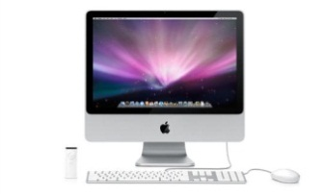
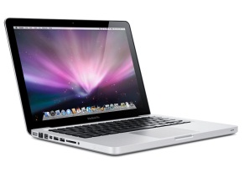
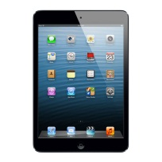
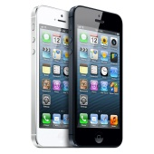



What do I need to run Cloudware?
Choose your internet capable device.
Connect to the Internet with your preferred Internet Service Provider (ISP).
Fixed
Mobile

Slide 15
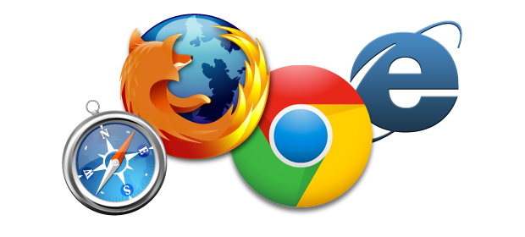

What do I need to run Cloudware?
3. Click on your favourite internet browser.
4. Run your chosen
Cloudware on any device

Slide 16
What do I need to run Cloudware?
The Geeky Bit
Nearly all internet capable devices made in the last 3 years will run Cloudware quite happily. Here is a run down of the minimum operating requirements recommended by Cloudware poviders.
For Windows PC users: The minimum systems requirements are: Windows 7, Windows 8, or Windows 2008 R2 with .NET 3.5 or later and Microsoft Internet Explorer 8, 9, or 10; Mozilla Firefox 10.x or a later version; or Google Chrome 17.x..
For OSX Mac users: The minimum system requirements are: Mac OS X 10.6 or later; Apple Safari 5 or above.
For iOS users:
For Android users:

